Slide 1
WGEA Regional Report 2016-2017 COMTEMA - OLACEFS
Junnius Marques Arifa
Head of the Department of Agricultural and Environmental Audit
TCU – Brazilian Federal Court of Accounts

Slide 2
Outline
Preparedness Audit Approach
Coordinated Audit
Capacity Building
Latin America Coordinated Audit
Future Initiatives
Notes:
By the end of this presentation you will be aware of the activities carried out by the OLACEFS regional group, the TCU initiatives and activities that may be carried out in the future.

Slide 3
COMTEMA Workplan 2015-2017
Coordinated Audit on SDG Target 2.4
Preparatory meeting held in Chile (Dec 2016)
Planning meeting held in Mexico (May 2017);
Consolidation meeting will be held in Asunción/PY (Nov 2017)
Election of the new presidency for the triennium 2018-2020
Notes:
We have an ongoing coordinated audit to evaluate the preparediness of the governments of Latin America for the achievement of the ODS 2.4 goal.
The results consolidation meeting is scheduled for November this year in Paraguay. This audit will be completed in 2018.
In addition, the election for the new presidency of COMTEMA will be held at the end of 2017.

Slide 4
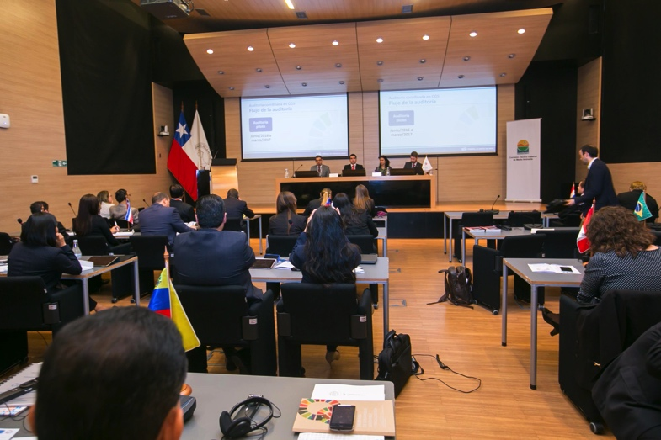
Preparing Meeting – Chile December 2016

Slide 5
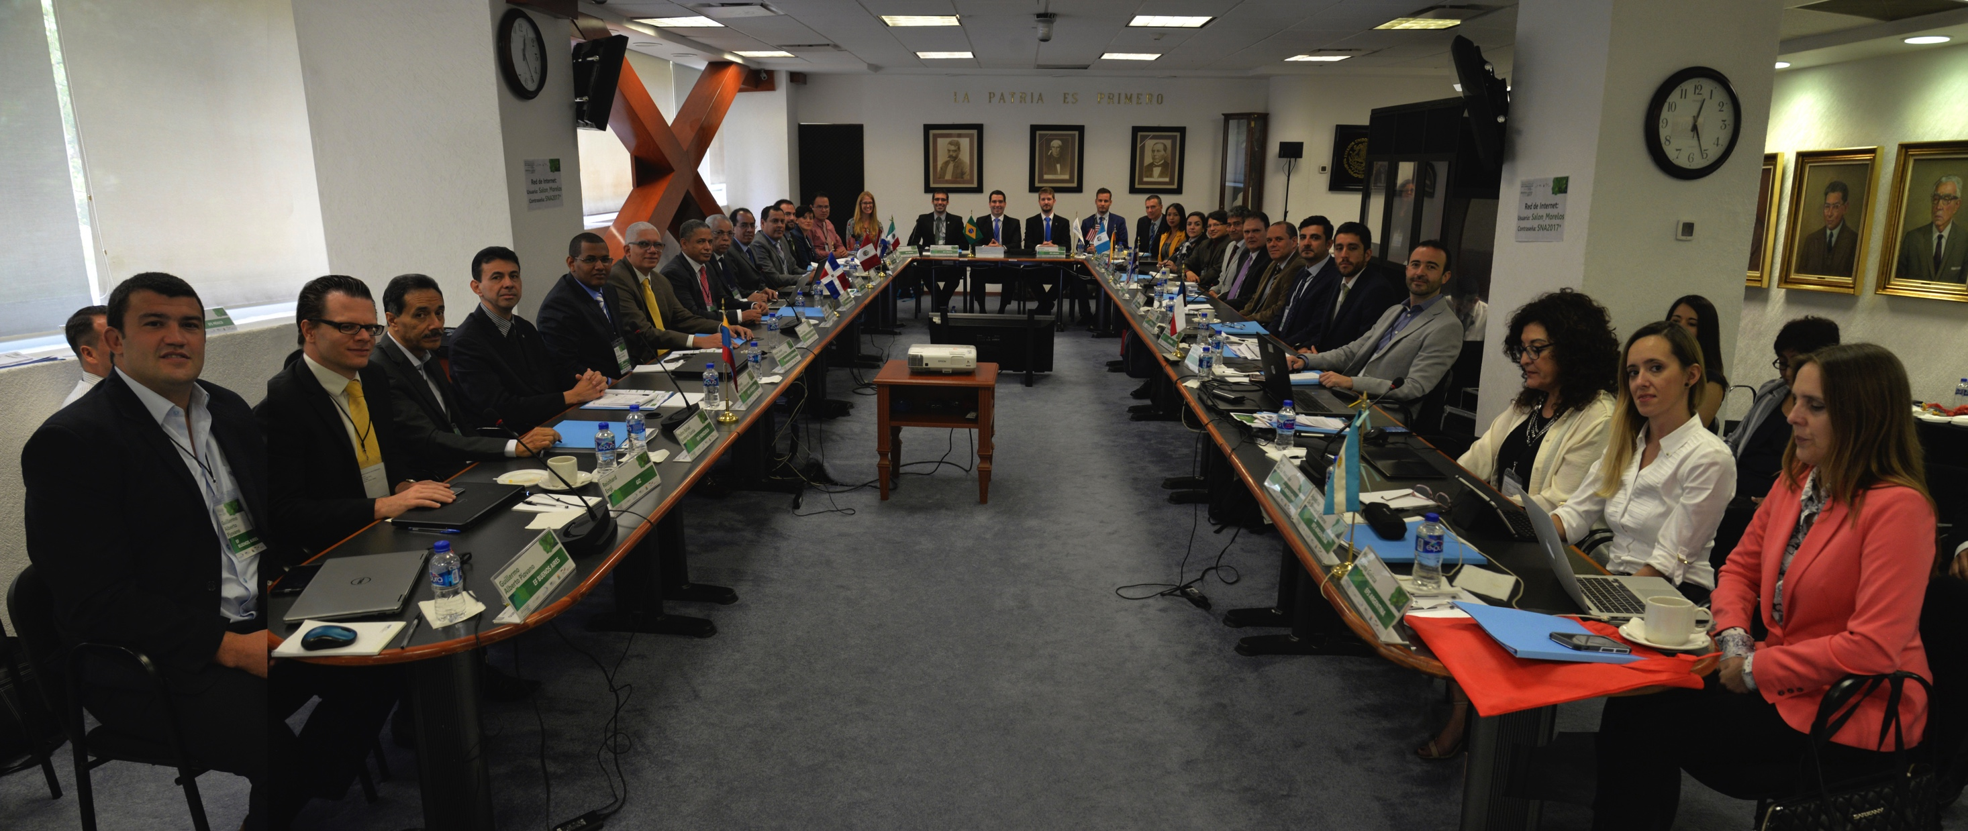
Planning workshop of SDG Coordinated Audit

Slide 6
Initiatives on SDGs for 2016-17
INTOSAI 4 approaches to SDGs and
1
2
3
4
Auditing national systems of follow-up
Performance audits on programmes that contribute to SDGs
Assessing and supporting SDG 16
Being model of transparency and accountability
Notes:
INTOSAI presents 4 approaches on how SAIs can contribute to the Agenda 2030. Approach 1 focus on auditing government’s national systems’ preparedness for implementing the SDGs. Approach 2 proposes conducting performance audits on programmes that contribute to the achievement of the goals. Approach 3 involves assessing and supporting SDG 16, which is “Peace, Justice and Strong Institutions”. Finally, approach 4 demands SAIs to be models of transparency and accountability.

Slide 7
Goal of the SDGs Approach
To build capacities and develop methods and tools in order to prepare to monitor the implementation of the Agenda 2030, with the possibility of replication of the method by other SAIs.
Notes:
We noticed that, in order to carry out a preparedness audit, we would need innovative methods and tools, as well as building capacities within its staff. We decided to call all these actions the “SDGs Project”.

Slide 8
Initiatives on SDGs for 2016-17
Audits
Knowledge management
National pilot audit
Method on SDGs auditing
Coordinated audit within Olacefs
Capacity building
Communication

Slide 9
Audit framework
Method for preparedness audit in SDGs
Center of Government
Agency A
Agency B
Whole-of-government approach
Policy A
Policy B
Policy C
cross-cutting
SDG Target
SDG Target
SDG
Target
Notes:
The preparedness audit perspective adopts the "Whole-of-government" approach. This means that the evaluation relies on the whole structure that government can use to achieve goals and targets - which includes the center of government, the various agencies and multiple public policies that can positively or negatively influence the achievement of those goals and targets.
The approach should allow to identify and assess coherence between center of the government agencies and if there are omissions, fragmentation, overlapping and duplications among the policies and the agencies mandate and acting.

Slide 10
7 Key elements
Method for preparedness audit in SDGs
Political Commitment
Building public awareness
Responsibilities and resources
Detailed planning
Designing and establishing systems
Baseline
Monitoring and reporting
Governance
{
Notes:
The preparedness audit approach evaluates elements of governance, such as planning, supervision, coordination and monitoring.

Slide 11
Governance mechanisms
Method for preparedness audit in SDGs
Center of government
Strategy
Coordination
Transparency
Supervision
Institutional
SDG target
Internalization
Cross-cutting coordination
Integrated monitoring
Transparency and participation
Notes:
We should assess governance structure in the level of the Center o Government and in the level of the SDG target. In the center of the governmente we are expected to assess the components of Intitutionalization, that means legislation/internalization initiatives. How the strategy is set in the planning system. How the government coordinate the different bodies that deliver the public policies, programs and activities, related to the SDG, from a systemic perspective, and how they supervise and bring transparency to their goals and its results.

Slide 12
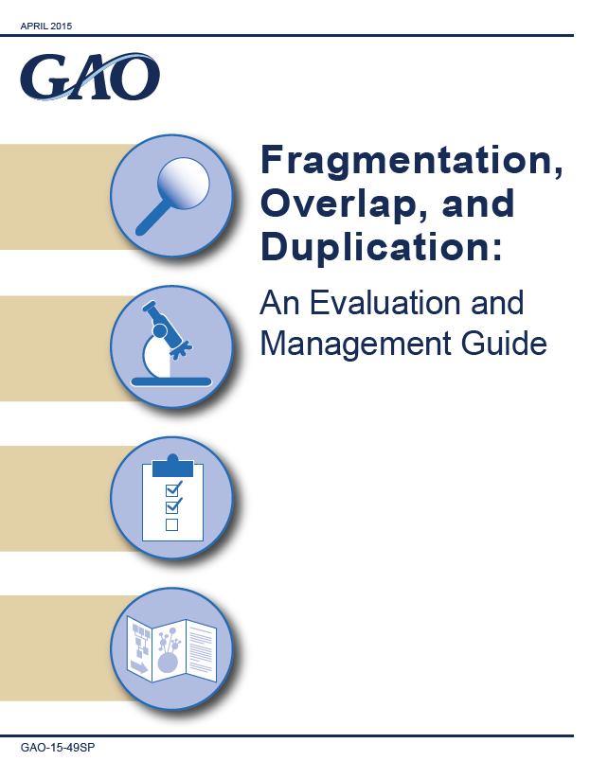
Starting Point
Approach for preparedness audit in SDGs
FOD methodology:
Identify fragmentation, overlap and duplication in public policies
Omission

Slide 13
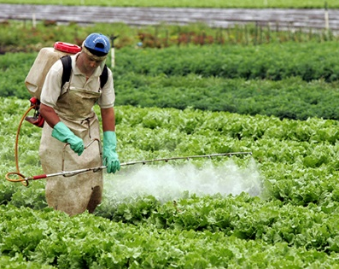
Improving Audit Approach
Method for preparedness audit in SDGs
Inputs
Inputs
Inputs
Blind spots
Blind spots
Fiscal policy
Organic production
Agrochemical
Outputs
Outputs
Outputs
Notes:
A traditional performance audit focuses on the inputs and outputs of a single public policy. Nevertheless, the traditional model is not suitable for assessing the achievement of goals and targets because:
1. multiple public policies can have effects on these goals;
2. Issues relevant to the achievement of these objectives may not be within the scope of any public policy.

Slide 14
Method: outputs
Approach for preparedness audit in SDGs
SDG prioritization and selection matrix
Standard work papers
Tools for data consolidation
Dashboard for assessment and monitoring of the SDGs
Notes:
The pilot audit tested the methodology, work papers and tools developed by the TCU to enable SAIs to assess the preparedness of local governments for the achievement of the most relevant goals according to local needs. The tools also allow the consolidation of the results to provide a global picture.
The SDG prioritization and selection matrix will be an important tool to choose the target, based on the criteria established previously.

Slide 15
SDG prioritization and selection matrix
Relevance
Materiality
Criticity
Value Aggregation
International treaties
Planning
Government initiatives
Inequalities treatment
Links to another goals
Budget Allocation
Critical factors
Public policies
Reality observation
Goal deadlines
Regional group initiatives
SAI initiatives
Notes:
The prioritization and selection matrix allows each SAI to identify the goals and targets most relevant to local needs, evaluating a set of criteria that includes relevance, materiality, criticality and value aggregation.
SAIs can select the criteria to be used and define the weight of each criterion according to local needs.

Slide 16
SDG prioritization and selection matrix
SDG
Target
2.4
2.5
6.2
6.3
Relevance
A | B | C | D | E
5 | 5 | 3 | 5 | 5
5 | 3 | 5 | 3 | 5
3 | 5 | 3 | 5 | 3
3 | 1 | 3 | 3 | 3
Materiality
A
5
3
3
1
Criticity
A | B | C | D
5 | 3 | 5 | 5
5 | 5 | 3 | 3
3 | 5 | 3 | 3
3 | 3 | 1 | 3
V. A.
A | B
5 | 3
3 | 3
1 | 3
1 | 1
Res
4,52
3,55
3,07
1,77

Slide 17
SDG Dashboard
Pilot audit

Slide 18
Capacity Building
- E-Learning on Performance Audit 2017/2018
Pre-Meeting on SDGs - 2016
E-learning on SDGs (future MOOC) 2017/2018
E-learning on environmental Audit – Biodiversity - 2018
Notes:
Besides the preparedness audit, this year TCU will be offering courses on the theme to SAIs in Latin America. At the present moment, there is already an ongoing course on performance audits. At the end of this action, TCU will start a specific course on SAIs’ roles in the implementation to the Sustainable Development Goals. This course will not only present the SDGs and discuss SAIs’ participation in the agenda, but also present the preparedness audit model.
This action is part of TCU’s role as a capacity building inducting actor, as the current President of Olacefs’ Capacity Building Committee.
This course also has the support of the German cooperation agency GIZ.

Slide 19
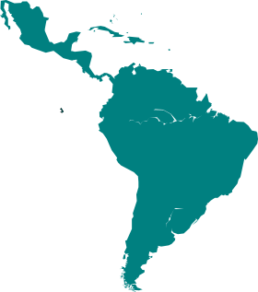
Latin American panorama
Coordinated Audit
Argentina
Brazil
Chile
Costa Rica
Dominican Republic
Ecuador
Guatemala
Mexico
Paraguay
Peru
Venezuela
Latin
America’s
Joint
Report
Consolidation
11 countries
Notes:
11 EFS are participating in the coordinated audit. The planning workshop was held in Mexico in May 2017; the results consolidation workshop will be held in Paraguay in November 2017. The final report will be presented in 2018.
Olacefs will be the first Intosai regional group to offer a picture about the level of preparedness of 11 Latin American countries to implement SDG.

Slide 20
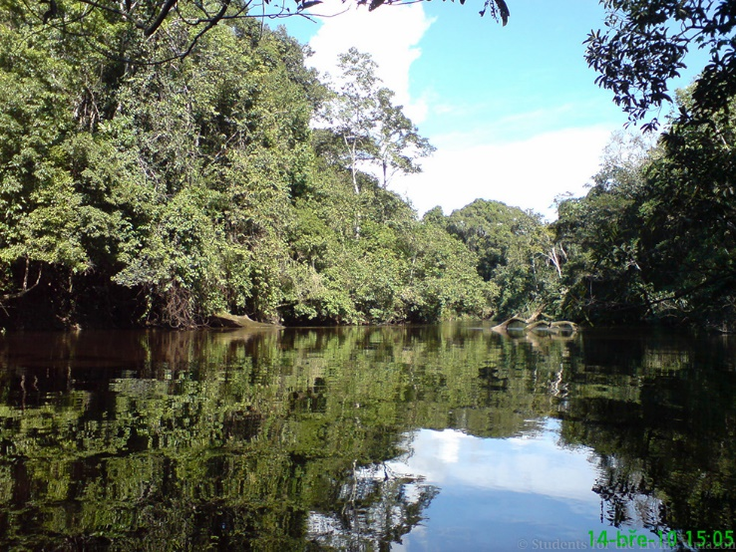
Protected Areas
Future initiatives
Notes:
The perspective of future actions applying the preparedness audit model includes assessing governance of protected areas, compared to the situation identified in previous audits.

Slide 21
Thank you!
Junnius Marques Arifa
junniusma@tcu.gov.br
+55 61 3316-5424

