Slide 1
Performance audit on
Water Provision

Slide 2
Content
1
Audit Scope and objectives
2
Water issues in Maldives
3
Government strategies
4
Audit findings
5
Recommendations

Slide 3
Audit Scope and objectives
The purpose of this audit is to assess the efficiency and effectiveness of government strategies relating to water provision.
The audit mainly focus on government strategies on provision water during dry period

Slide 4
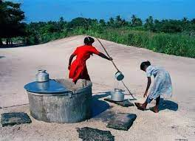
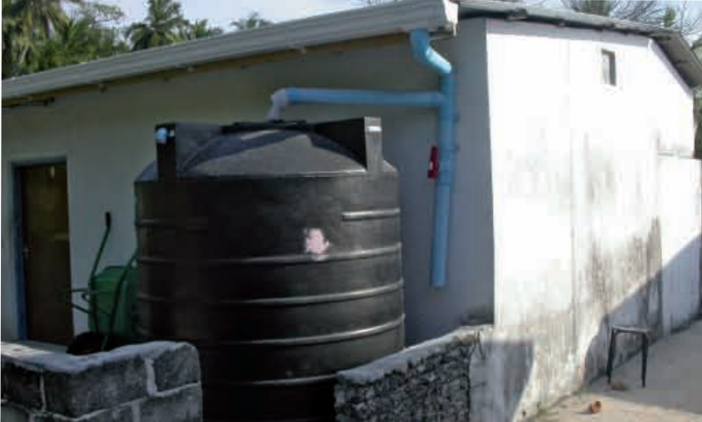
Water Issues in Maldives
Sources of water
Groundwater
Rainwater
Due to climate change factors, such as rising sea levels , changing rainfall patterns, have affected the water supply

Slide 5
Government strategies
Emergency water supply
Rain water harvesting system
Water Production facilities

Slide 6
Audit findings
Emergency water supply
Emergency water supply has been ongoing constantly over the last 15 years
The number of islands and costs shows inconsistent trend over the years
Notes:
We found that emergency water supply has been ongoing constantly over the last 15 years. Despite, government’s efforts to implement permanent solutions we found that, it did not significantly reduce the demand for emergency water.
Ranging from supplying emergency water – a reactive / emergency relief measure – to implementing rainwater harvesting systems and water production facilities – These are aimed at finding permanent solutions to the water shortage problem.

Slide 7
Audit findings
Quantities of water supplied (2005 to 2020)
Notes:
We found that emergency water supply has been ongoing constantly over the last 15 years. Despite, government’s efforts to implement permanent solutions we found that, it did not significantly reduce the demand for emergency water.

Slide 8
Audit findings
Water supplying costs and number of islands
Notes:
We found that emergency water supply has been ongoing constantly over the last 15 years. Despite, government’s efforts to implement permanent solutions we found that, it did not significantly reduce the demand for emergency water.

Slide 9
Audit findings
Rainwater harvesting system
RWP has been implemented in 47 islands
Several RWP fails to complete within the agreed timeframe
Project objectives are not met, as 70% of these islands supplied water after project implementation
Notes:
For some of the projects ,

Slide 10
Audit findings
Water Production facilities
This projects were not initially targeted to most vulnerable islands
The current government policy is to implement these projects in all islands
The WPF has been implemented in 44 different islands. And contracts has been made for remaining islands
Notes:
c) As for water production facilities we found that these projects were not targeted to the most vulnerable atolls and islands. As you can see the north of Maldives are more vulnerable to water shortages than the central and the south. However, as seen, implementation of water production facilities have not prioritized these areas. I would also like to note that the current government policy is to establish water production facilities in all inhabited islands and they contracted these works.

Slide 11
Audit findings
Most vulnerable islands and project status
Notes:
c) As for water production facilities we found that these projects were not targeted to the most vulnerable atolls and islands. As you can see the north of Maldives are more vulnerable to water shortages than the central and the south. However, as seen, implementation of water production facilities have not prioritized these areas. I would also like to note that the current government policy is to establish water production facilities in all inhabited islands and they contracted these works.
This map shows the comparison of most vulnerable islands, and project implemented in these islands,
We found that the projects were not progressed significantly in these regions.

Slide 12
Recommendations
Evaluate the existing water supplying model, and identify cost effective mechanism for water supplying process.
Monitor project completion schedules,, with special priority given for islands undergoing repeated water supply requests and thus reducing additional water supplying costs
Negotiate with relevant parties to speed up the water supplying process
Notes:
c) As for water production facilities we found that these projects were not targeted to the most vulnerable atolls and islands. As you can see the north of Maldives are more vulnerable to water shortages than the central and the south. However, as seen, implementation of water production facilities have not prioritized these areas. I would also like to note that the current government policy is to establish water production facilities in all inhabited islands and they contracted these works.

Slide 13
THANK YOU
www.audit.gov.mv

